Slide 1

SUPER STORE USA
BUSINESS ANALYSIS
10/03/2025

Slide 2
About Superstore USA
Super Store is a retail outlet in the United States that deals specifically with products categories ranging from, furnitures, office supplies, and technology gadget.
Super Store operates in the United States and serve customers in 49 states. Which make logistics a key aspect of their operations.
Due to the nature of the business, Superstore’s serves a range of customer segment, including; Home office, Corporate organisations, small businesses and even individual customers.
DASH BOARD

Slide 3
Problem Statement
In a typical retail store like Superstore, business operation often require the gathering of several data about different aspect of the business operation. This helps to capture data about things like logistics, sales, product, discount etc.
Many times high sales, does not always equal high profit as business are not just in business to generate sales but rather profit.
Determining what constitutes profits or loss is not straight further particularly when dealing with large businesses, with different product offering, different customer segment, and other factors like logistics, discount strategies etc.
Considering this, it becomes important to investigate how different factors collectively and/or individually impacts on sales and profits or losses.
This investigation does not provide insight but serves an input to make data-driven business becision.
DASH BOARD

Slide 4
Sales & Profitability
Product Category that Drives the Most Revenue and Profit
The Technology Categroy drives the highest revenue ($712K) and a relatively high profit of ($75K), acting as a primary growth factor for both sales and profit.
Office Supplies on the other hand yields the highest profit ($89K) despite lower revenue ($551K).
Products that Frequently Sell at a Loss
Specific tech items (e.g., Polycom ViewStation, 5165, Okidata Pacemark 4410N Wide Format Dot Matrix Printer) and some furniture consistently incur losses, likely from excessive discounting, high operational costs or product defect.
DASH BOARD

Slide 5
Recommendation: Sales and Profit
Prioritize: focus more on Technology and Office Supplies by leveraging their strong margins. Invest more on this categories, with promotional strategies especially among high yielding regions and customer segment.
Reevaluate Product Losses: The is a need to reevaluate, the Furniture category to address cost issues and adjust pricing strategies. Further analysis is required to understand what is responsible for the loss. If the product cannot be repriced it should be discontinued.
DASH BOARD

Slide 6
Discount Strategy
Discount Impact on Sales & Profit: The analysis indicates that discounts stimulate higher sales volume; however, deep discounts tend to compress profit margins.
Increased Discounts: May boost sales but risk eroding overall profitability if not carefully managed.
Decreased Discounts: Could preserve profit margins but might reduce sales volume if customer price sensitivity is high.
Optimal Discount Rate: The dataset suggests that moderate discount levels, typically within the lower range of the discount bracket yield the best balance between driving sales and maintaining profit. Excessively high discounts correlate with lower profit margins, particularly for high-cost items.
DASH BOARD

Slide 7
Recommendation: Discount Strategy
Moderate Discount: Apply a modest discounts to optimize sales while preserving profit margins, especially in high-margin categories.
Dynamic Pricing and Discount Adjustments: Employ data-driven adjustments based on product category, historical discount performance, and market conditions. Monitor discount impact on sales and profit from time to time.
Product-Specific Discounting: For products that consistently sell at a loss under heavy discounting, reprice is recommended to a moderate discount or consider discontinuation.
DASH BOARD

Slide 8
Shipping & Logistics
Regular Air: arguably, Regular Air offers the best balance of cost and deliver time, with an average cost of $7.64 and an average of 1.97 days for delivery.
Express Air: Express Air also offers a good balance for customers that are willing to pay a little more for a faster delivery time. Express air cost an average of $9.13 and an average of 1.8 days for delivery.
Delivery Trucks: while this shipping method offers a faster delivery time of 1.89 days than Regular Air, it is however, too expensive ($44.14) and may incur more cost for both customers and superstore management..
DASH BOARD

Slide 9
Recommendation: Shipping and Logistics
Standardize on Regular Air: Superstore should adopt Regular Air as the default shipping method to ensure a balance between cost-efficiency and reliable delivery speed.
Express Delivery Service: Reserve Express Air for high-priority orders where faster delivery justifies the cost and customer are also willing to pay more.
Develop Local Hubs: Superstore should establish regional distribution centers to reduce Long-distance shipping. It saves both cost and time, overall enhance customer satisfaction.
Negotiate with Local Carriers: Create partnerships with regional carriers to secure competitive shipping rates.
Optimize Routing: Superstore should consider the use logistical Algorithm like Dijkstra to determine the shortest route on the road network for the delivery order.
Furthermore, Super store should leverage data analytics to streamline routes and combine shipments, thereby lowering overall shipping expenses.
Theree is a need to investigate what contribute to the high cost of delivery Truck and based on the outcome discontinue the use or re-strategies.
DASH BOARD

Slide 10
Regional Insights and Recommendation
The highest sales and profit is made in the Eastern Region, therefore more effort should be into introducing marketing strategies that helps retain sales in this region.
For West and Central, there is the need for superstore to invest in more marketing strategies that help the business gain more visibility in this region, and also simultaneous help to increase profit. This may include using targeted advert, or region specific marketing strategies.
Furthermore, Superstore need to further investigate the cause of losses and low sales in the south region.
DASH BOARD

Slide 11
Customer Segmentation
Corporate Customer Segment: this segment drives the highest revenue. Corporate is the leading segment in terms of quantity ordered, indicating a strong demand volume.
Consumer and Small Business show relatively lower order volumes, but their impact differs in terms of profitability.
Corporate segment dominates in revenue contribution, reinforcing its strategic importance.
Small Business generates the lowest revenue, despite similar demand as Consumer.
Small Business segment leads in profit, showing efficient margins despite lower sales. Consumer segment has the lowest profit, indicating potential margin issues.
Small Business is the most efficient in terms of profit generated per unit sold. Corporate, while leading in volume and sales, shows the lowest profit efficiency per unit.
DASH BOARD

Slide 12
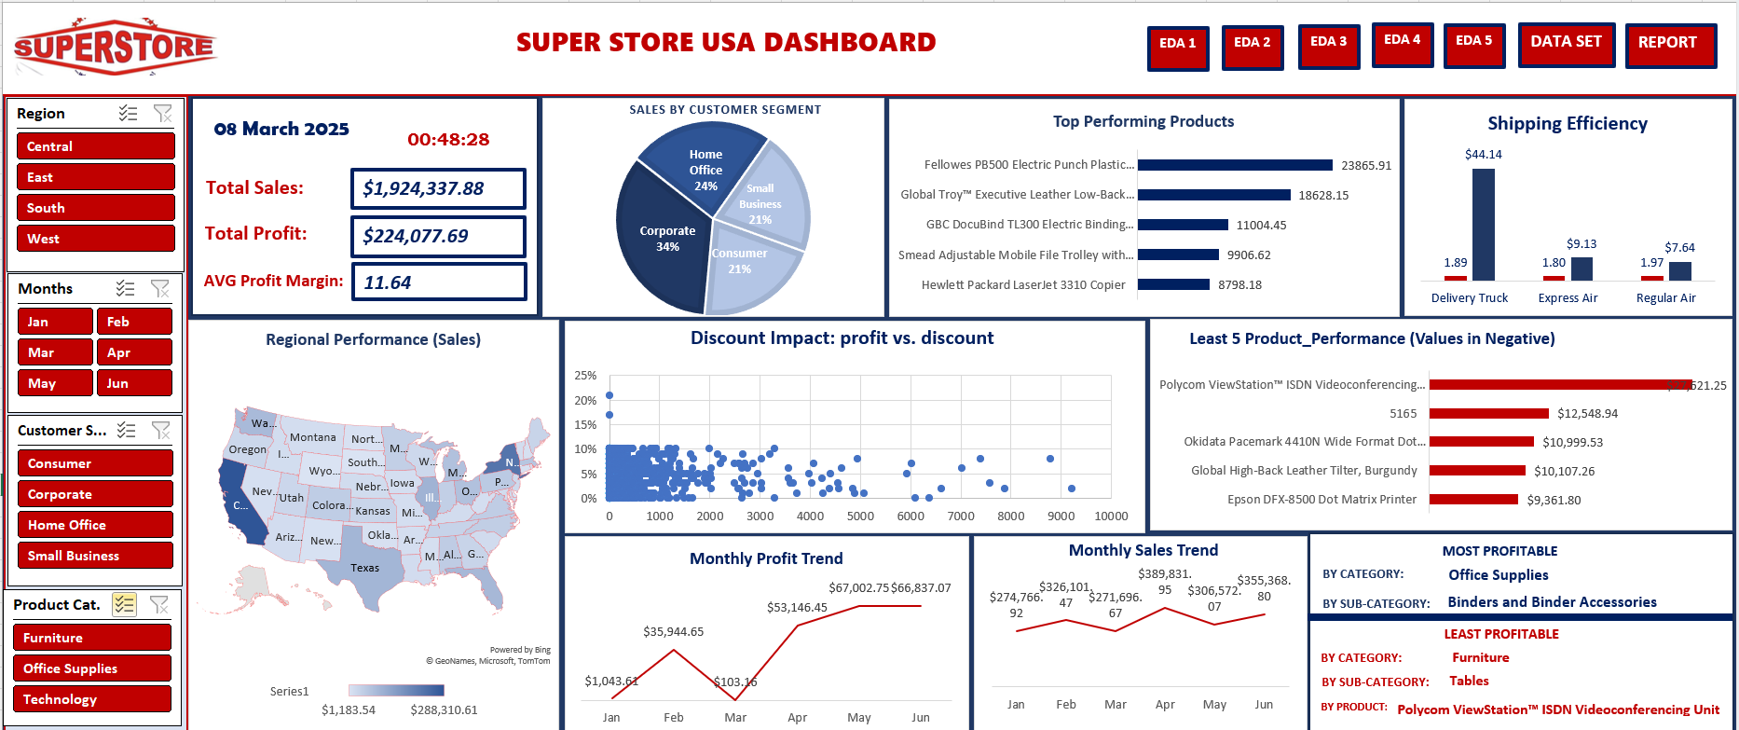
SAMPLE ANALYSIS DASHBOARD

Slide 13
THANK YOU

